Slide 1
Software Engineering
Lecture-11

Slide 2
Verification vs validation
Verification:
"Are we building the product right”.
The software should conform to its specification.
Validation:
"Are we building the right product”.
The software should do what the user really requires.

Slide 3
The V & V process
Is a whole life-cycle process - V & V must be applied at each stage in the software process.
Has two principal objectives
  The discovery of defects in a system;
  The assessment of whether or not the system is useful and useable in an operational situation.

Slide 4
V& V goals
Verification and validation should establish confidence that the software is fit for purpose.
This does NOT mean completely free of defects.
Rather, it must be good enough for its intended use and the type of use will determine the degree of confidence that is needed.

Slide 5
Static and dynamic verification
Software inspections. Concerned with analysis of
the static system representation to discover problems (static verification)
  May be supplemented by tool-based document and code analysis.
Software testing. Concerned with exercising and
observing product behaviour (dynamic verification)
  The system is executed with test data and its operational behaviour is observed.

Slide 6
Program testing
Can reveal the presence of errors NOT their absence.
The only validation technique for non-functional requirements as the software has to be executed to see how it behaves.
Should be used in conjunction with static
verification to provide full V&V coverage.

Slide 7
Testing and debugging
Verification and validation is concerned with establishing the existence of defects in a program.
Debugging is concerned with locating and
repairing these errors.
Debugging involves formulating a hypothesis
about program behaviour then testing these
hypotheses to find the system error.

Slide 8
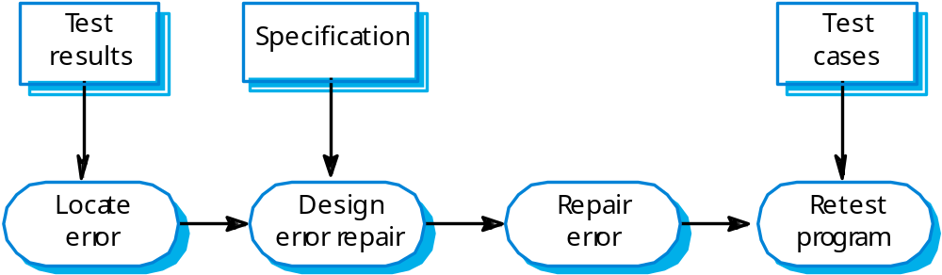
The debugging process

Slide 9
V & V planning
Careful planning is required to get the most out of testing and inspection processes.
Planning should start early in the development process.
The plan should identify the balance between static verification and testing.
Test planning is about defining standards for the testing process rather than describing product tests.

Slide 10
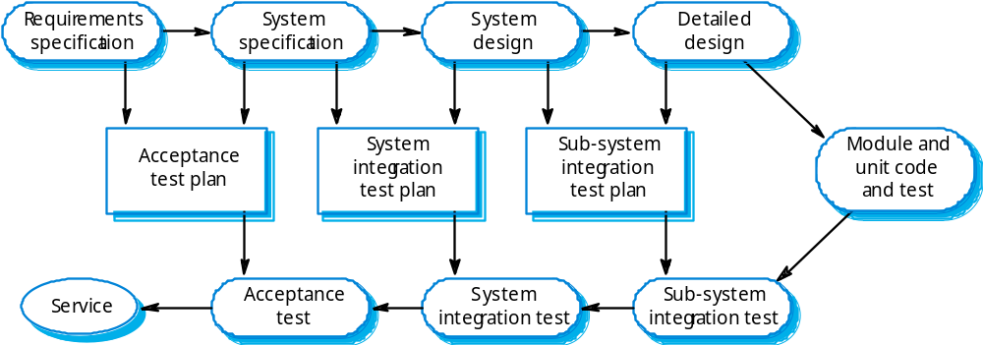
The V-model of development

Slide 11
Software Testing
Testing is the process of exercising a program with the
specific intent of finding errors prior to delivery
to the end user.
OBJECTIVE:
to uncover errors
CRITERIA:
in a complete manner
CONSTRAINT:
with a minimum of effort and time

Slide 12


Who Tests the Software?
developer
independent tester
Understands the system
Must learn about the system,
but, will test "gently"
but, will attempt to break it
and, is driven by "delivery"
and, is driven by quality

Slide 13
Testing policies
Only exhaustive testing can show a program is free from defects. However, exhaustive testing is impossible,
Testing policies define the approach to be used in selecting system tests:
  All functions accessed through menus should be tested;
  Combinations of functions accessed through the same menu should be tested;
  Where user input is required, all functions must be tested with correct and incorrect input.

Slide 14
Levels of Testing
Unit testing
Integration testing
Validation testing
  Focus is on software requirements
System testing
  Focus is on system integration
Alpha/Beta testing
  Focus is on customer usage
Stress testing
  executes a system in a manner that demands resources in abnormal quantity, frequency, or volume
Performance Testing
  test the run-time performance of software within the context of an integrated system.

Slide 15



Unit Testing
module
to be
tested
results
software
engineer
interface
local data structures
boundary conditions
independent paths
error handling paths
test cases

Slide 16
System Testing
Involves integrating components to create a system or sub-system.
May involve testing an increment to be delivered to the customer.
Two phases:
  Integration testing - the test team have access to the system source code. The system is tested as components are integrated.
  Release testing - the test team test the complete system to be delivered as a black-box.

Slide 17
Integration testing
Involves building a system from its components and testing it for problems that arise from component interactions.
To simplify error localisation, systems should be incrementally integrated.

Slide 18
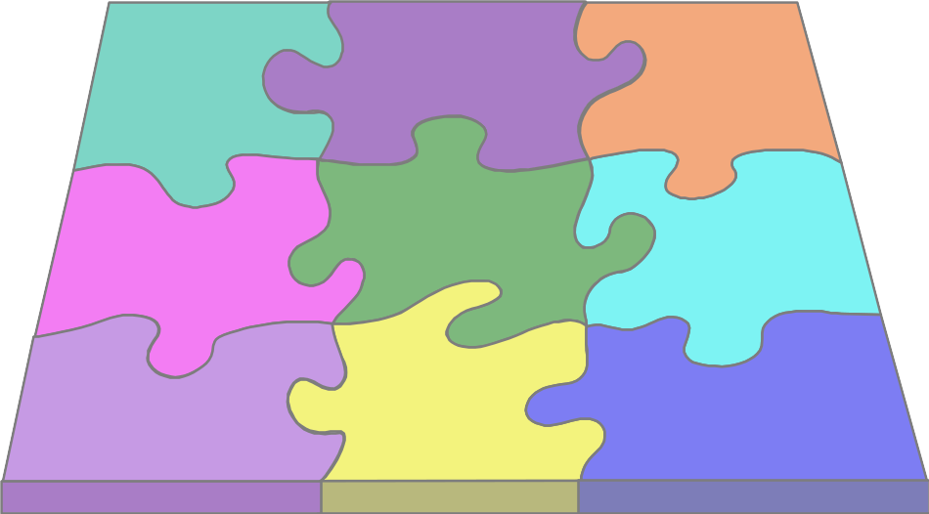
Integration Testing Strategies
Options:
  • the “big bang” approach
  • an incremental construction strategy

Slide 19
Release testing
The process of testing a release of a system that will be distributed to customers.
Primary goal is to increase the supplier’s confidence that the system meets its requirements.
Release testing is usually black-box or functional testing
  Based on the system specification only;
  Testers do not have knowledge of the system implementation.

Slide 20
What is a “Good” Test?
a high probability of finding an error
not redundant.
neither too simple nor too complex

Slide 21
Exhaustive Testing
loop < 20 X
14
There are approx. 10 possible paths! If we execute one
test per millisecond, it would take 3,170 years to
test this program!!

Slide 22
Software Testing Techniques
White-box Testing
  Executing and checking all statements in the code
Black-box Testing
  Testing the system as a black box, giving only inputs and seeing outputs.

Slide 23

White box Testing
... our goal is to ensure that all
statements and conditions have
been executed at least once ...

Slide 24
Black Box Testing
requirements
output
input
events

Slide 25
Loop Testing
Simple
loop
Nested
Loops
Concatenated
Loops
Unstructured
Loops

Slide 26
Testing OO Systems
class testing is the equivalent of unit testing
  operations within the class are tested
  the state behavior of the class is examined

Slide 27
Test case design
Involves designing the test cases (inputs and outputs) used to test the system.
The goal of test case design is to create a set of tests that are effective in validation and defect testing.

